Slide 1

American Lawn Care Insanity
Air + Noise Pollution: Costs without Benefits
by Maria Gregory
for English Composition class
April, 2018

Slide 2

Thesis
Gas-powered lawn maintenance activities have very negative environmental and health impact.
How come this practice is still in place?
Why are American priorities in favor of a visually flawless lawn rather than health and well-being?

Slide 3

History
18th century, England: mixed-grass meadows cropped by cattle, sheep, or deer. In smaller areas, grass was cut by scythes.
Wealthy Americans imported, planted, and cut grass to show-off their status.

Slide 4

History (cont.)
1800s: Edwin Budding created a first reel-type mower.
1900s: Garden Clubs of America stipulated that a proper lawn is: "a plot with a single type of grass with no intruding weeds, kept mown at a height of an inch and a half, uniformly green, and neatly edged."

Slide 5

History: 1950s-1960s
After the WWII, men used the gas-powered lawn-mowers in their yards.
1950s: mowers were marketed as "little cars“
1961, C.B. Mills, an agronomist, about mowers:
"Today, if all of them in a single neighborhood were started at once, the racket would be heard round the world."

Slide 6
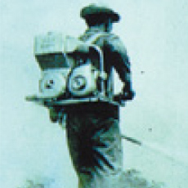

History: Dust Blowers
Once upon a time, there was a crop duster, designed to spray pesticides in plant nurseries.
by Japanese-based Kyoritsu Noki
In United States – renamed to Echo Inc.
Then, users removed pesticides from the tank and used the sprayer to move leaves and debris.
Exploded in popularity in 1970s-1980s.
BUT negative environmental impact,
SO they got banned in 1975 in Carmel, CA.
In the mid-1990s, Echo Inc. redesigned their engines to reduce noise emissions by 75%.
but still…

Slide 7

History: Today
American obsession with lawns is a big business:
Lawns cover 40 million acres, 4x more than of irrigated corn. (Diep)
Yearly, Americans spend more than $40 billion on lawn care (Steinberg 5) more expensive than growing corn, rice, or sugarcane.
Lawn equipment is a big contributor to the pollution problem.

Slide 8


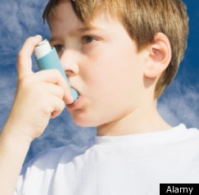

Costs: Health
asthma
respiratory disease
chronic obstructive pulmonary disease
lung cancer
cardiovascular disease
hypertension (due to noise)
neurologic disorders
effects on prenatal development (lower IQ, nervous system disorders)
premature births
hearing loss

Slide 9





Costs: Health (cont.)
Chemicals
Effects
Carbon monoxide (CO)
Benzene, 1,3-butadiene, formaldehyde
Volatile organic compounds VOC + NOx ⁻⁻⁻> ground-level ozone
Peroxyacetyl nitrate (PAN)
Dust: mold, spores, pollen, pesticides, toxic metals
Heart problems.
Cancers: lymphomas, leukemias, etc.
Heart and lung diseases
Eye irritation
Allergies, organ failure, lower IQ in children

Slide 10

Costs: Legal
Reality ?
Riverside
Municipal Code
Title 7
55 dBA for residential areas,
from 7AM – 10 PM
75 dB from 50 feet away
100 dB at operator’s ear.
Campaign in Hamptons, Long Island, Suffolk County, NY

Slide 11
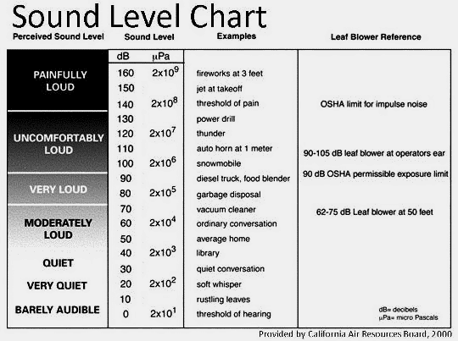
Costs: Legal (cont.)

Slide 12

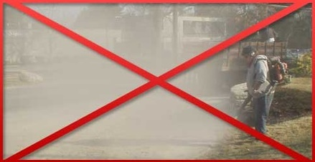

Costs: Legal (cont.)
More than 20 CA cities banned leaf blowers:
Santa Monica, since 1991 Cite $250 - $1,000
Berkeley, since 1990
Beverly Hills, since 1986
Santa Barbara, since 1997
Claremont, since 1991
Laguna Beach, since 1993
Newport, since 2011
Palm Springs, 2019 (only gas-powered ones)
etc.
Sign showing that leaf blowers are banned in an area.
Video: Are leaf blowers really necessary? (1:40)
Campaigns:

Slide 13

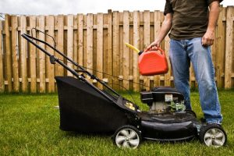
Costs: Financial
$$$
800 million gallons of gasoline yearly, 17 million gallons is spilled.
30% of fuel is unburned – inefficient power plant.
Replacing and maintaining gears
Hot dry wind 185+ mph soil damage additional $$ for “treatment”
Headaches, reduced productivity:
Lower paycheck
Medical bills
Hiring lawn ”service” (blower guys)
blowing all the leaves into the road (or to your neighbor’s yard) for the wind (or neighbor) to bring them back within a week.

Slide 14
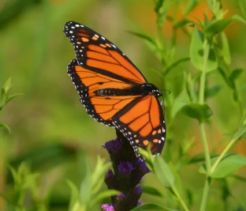
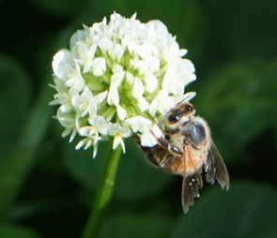
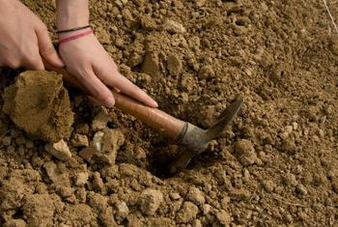

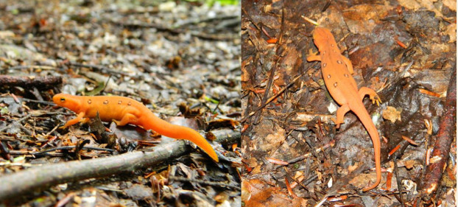
Costs: Ecological
Fuel spillage oil in waterways and soils
Soil drying and hardening
killing vital soil-dwelling organisms
limited infiltration flooding
reduced soil productivity
Plants:
desiccating roots,
fungal diseases spread
Decreased biodiversity
Global warming
Photos by Dani Tinker

Slide 15
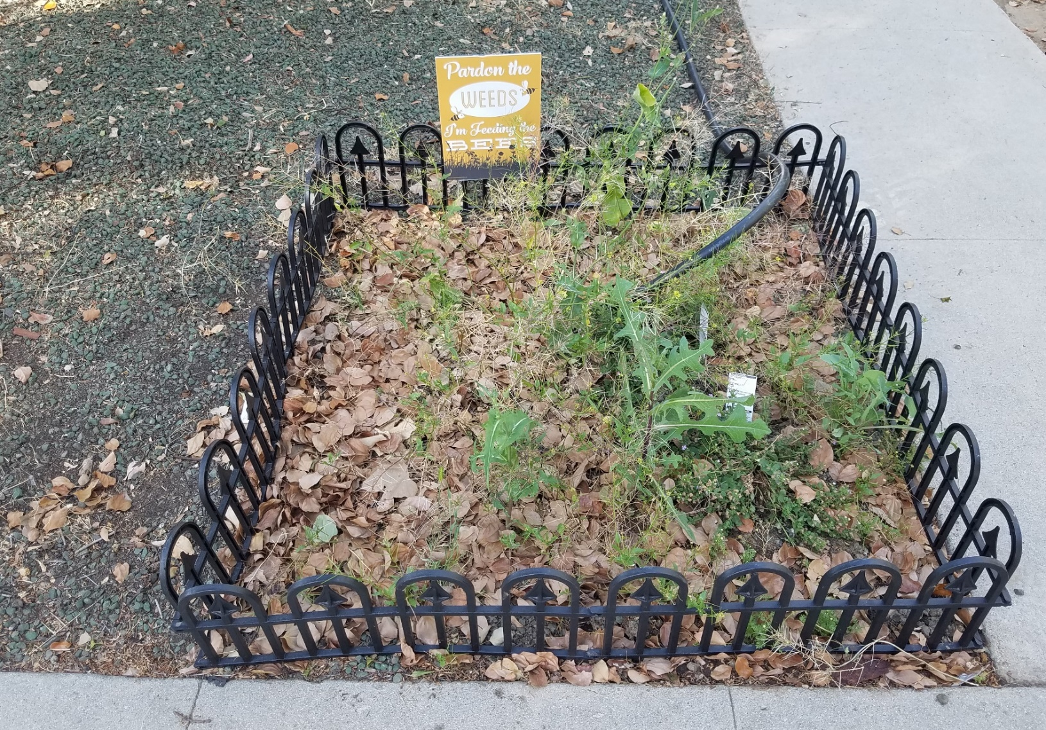
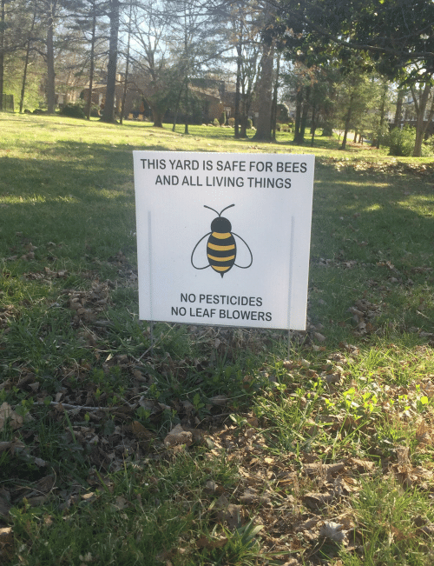
Costs: Ecological (cont.)
Bandini street, Riverside, CA. Photo by me

Slide 16
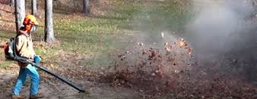
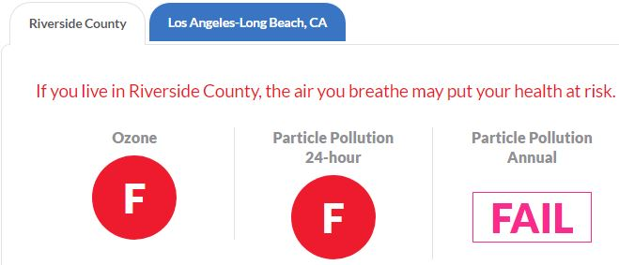
Costs: Ecological (cont)
American Lung Association
For the record, Sonoma and Monterrey counties banned leaf blowers.
Country | Ozone pollution | Particle pollution
Riverside | F | F
Sonoma | A | A
Monterrey | A | B

Slide 17
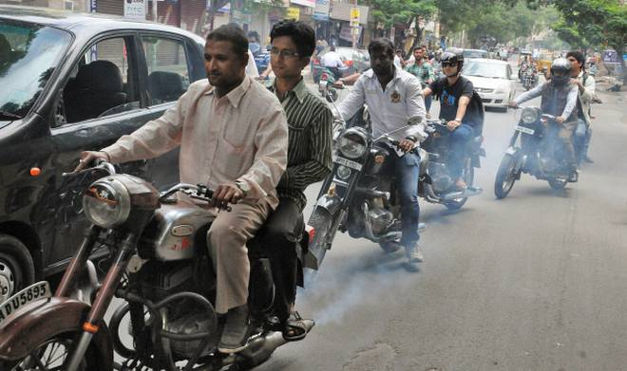
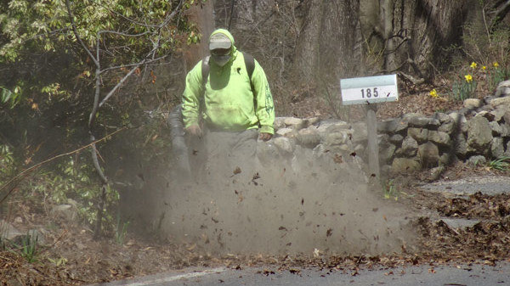
Causes: Technical 2-stroke engines
Autorickshaws in Delhi, India
United States
Benefits: cheap, lightweight, allow operators to stay lazy, fat, inefficient, and brain-dead zombies

Slide 18
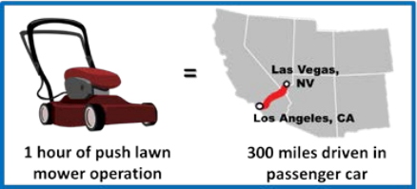
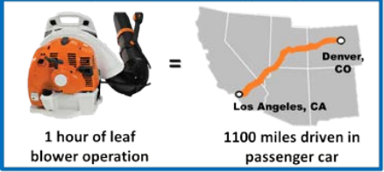
Causes: Technical 2-stroke engines (cont.)
California Air Resources Board, Environmental Protection Agency:
1/3 of the fuel is unburned → we breathe it
Emissions:
300 times the hydrocarbons of the pickup truck
93 times the hydrocarbons of the sedan
(on 2016 Toyota Camry)
Source:
Emissions Test: Car vs. Truck vs. Leaf Blower

Slide 19
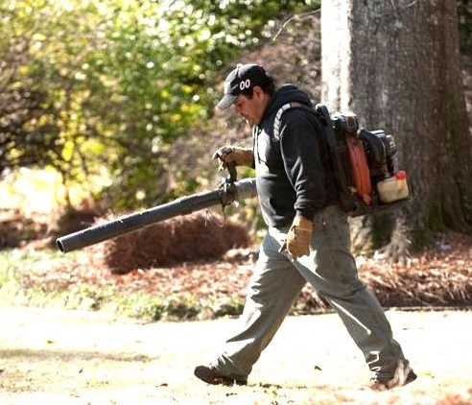
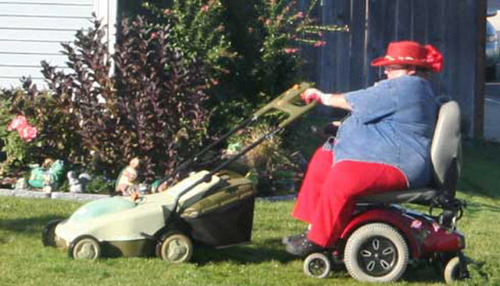

Causes: Human-Based
240 calories an hour – raking leaves
298 calories per hour – manual lawn mowing
Upper-body and core strength.
Laziness
VS.

Slide 20

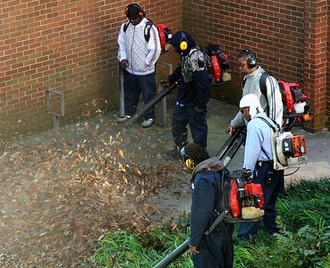

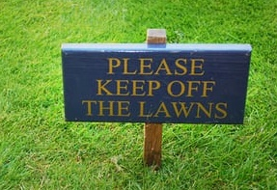
Causes: Human-Based (cont.)
Have you blown your mind?
Ignorance
Not-in-my-backyard “gardening”: throwing your problems off your turf for someone else to deal with…
A Leaf-Cleanup Confession by Todd Burger:
“But if the rains and flooding do come, at least my yard will be leaf-free.”

Slide 21
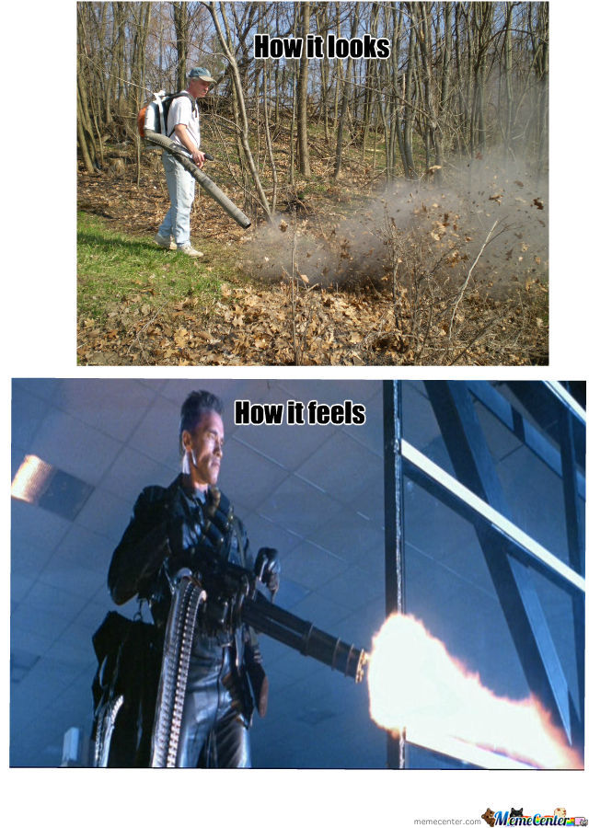
Causes: Human-Based (cont.)
Superiority complex
Desperate wish to be noticed
Feeling of a “gun”
Video: Are leaf blowers really necessary?

Slide 22


On the Other Side: Anything Good?
California Landscapers Contractors Association:
“…an outright ban of this valuable equipment would be the severest of all possible remedies and one that would eliminate its many benefits.”
[gas-powered leaf blower] … extremely efficient and safe tool.
Leaf blowers perform functions that no other tool can handle […] with minimal disturbance.
… WHAT?

Slide 23


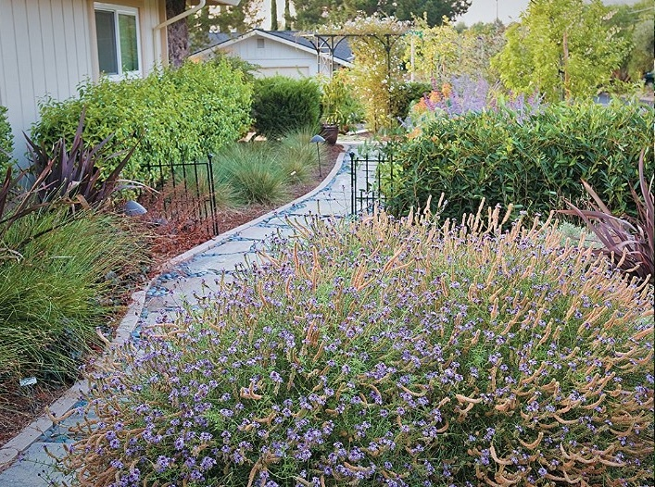

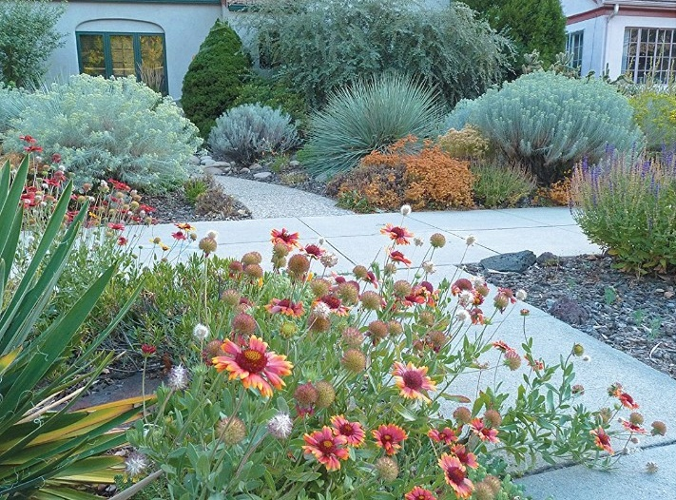
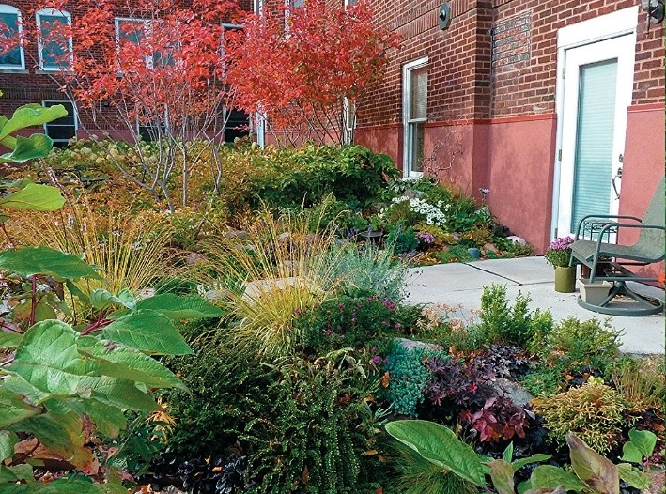
Solutions: Reconsider the Landscape

Slide 24


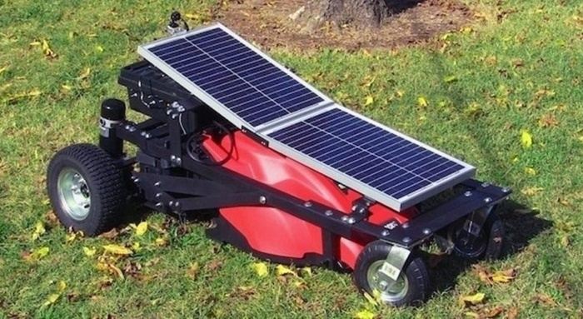


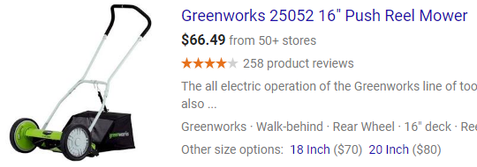
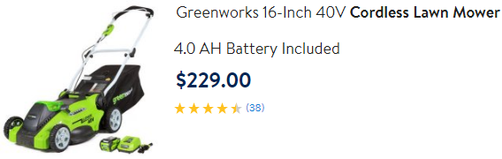
Solutions: Switch the Tools
Electric lawn-mowers
“Rake and Broom”
Greatest control over placements of leaves
Great exercise on a fresh air
Solar-powered
Solar-powered Lawn Mower with Remote Control
Push Handle Mower

Slide 25
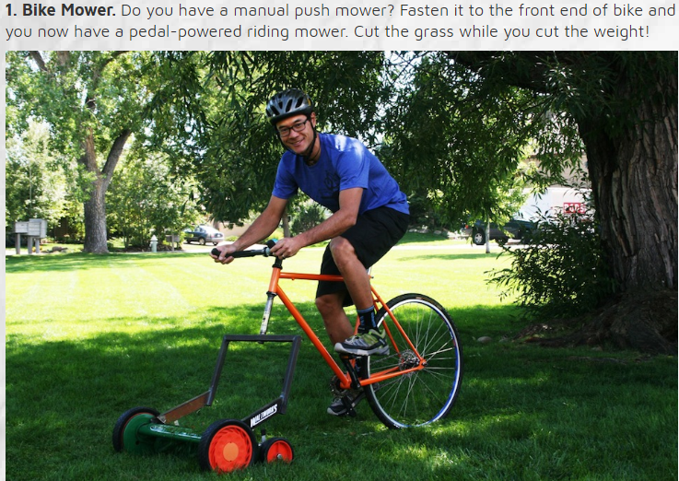
Solutions: Switch the Tools (cont.)

Slide 26


Solutions: Live and Let Live
Find another purpose in life.

Slide 27

Solutions: Live and Let Live (cont.)
Sarah Baker.
“My township calls my lawn
‘a nuisance.’ But I still refuse to mow it.”
Source: Washington Post
Sarah Baker and her partner in their yard.
Alexandria, Ohio.
Town officials have declared it “a nuisance.”
(by Amanda Taylor)

Slide 28
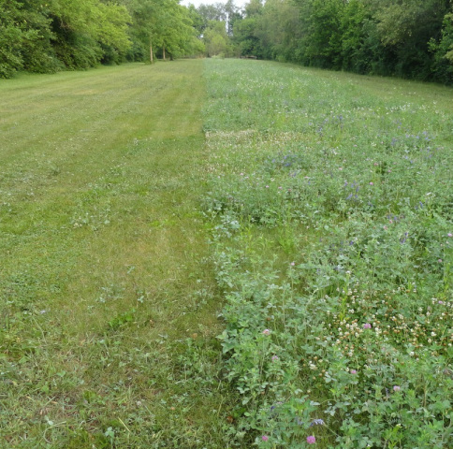
Voting: Which lawn is better?
Mowed
Un-mowed
What would a rabbit choose?
(see the next slide)

Slide 29




Questions?
Source: Druid Garden

